Slide 1
2. Elements of C++

Slide 2
Mrs. K.V.Bhatt
Lecturer, Information Technology,
SBMP

Slide 3
Learning Outcomes
Students will be able to:
Describe character set, constants and tokens
Use data types as per requirements in the problem statement
Describe and use operators appropriately.
Apply conditional and branching statements to solve the given problem statements

Slide 4
Basic constructs of C++

Slide 5
Character Set
Alphabets : A-Z , a-z
Digits : 0 – 9
Special Symbols : %, #,, [ , ] , *, & , etc.
White Spaces : space, tab, carriage return

Slide 6
Tokens
In a passage of text (English) individual words, punctuation marks (, ! ? .) and spaces are called as tokens.
In Programming Languages individual units in a statement are called tokens.
C++ tokens are:
Keywords
Constants
Identifiers
Strings
Operators

Slide 7
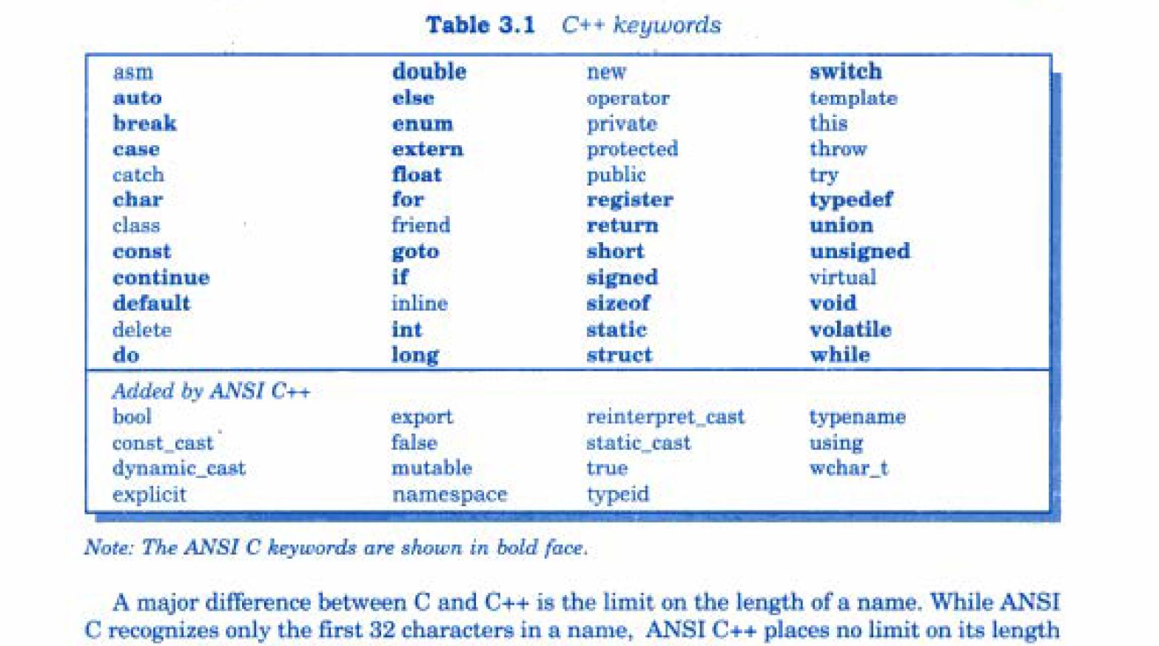
Tokens: Keywords
Reserved identifiers having specific meaning which can not be changed
Can not be used for variables or user defined program elements.

Slide 8
Tokens: Constants
Fixed values that do not change during the execution of a program.
Constant Type | Valid | Invalid
Integer | 23, 3456, 127 | 23,340 23 350 $23
Float / Real values | 1.2345, 0.1234, 1.234e+02, 1.4567e-02
Character | ‘A’ , ‘a’, ‘$’ , ‘@’ | A, a, $ , @
String | “Hi” , “New York” | ‘Hi’, Hi

Slide 9
Tokens: Identifiers
Refers to the name of variables, arrays, functions and classes
variable = which can vary its value
Used to store operands used in expressions and to store the results
i.e. a=5, b=2
c= a+b
Rules:
Combination of alphabets , digits and underscore ( _ )
Can not start with a digit
Can not be a keyword
Uppercase and Lowercase are significant
First 31 characters are significant

Slide 10
Tokens: Identifiers
Valid Variables: -
avg, avg1, class_strength, _sum, int_num
Invalid Variables:-
1avg, currency$, class strength, int, switch

Slide 11
Identifiers and variables are used interchangeably

Slide 12
Tokens:Strings and Operators
Strings: Group of characters are represented as String . They are written in “ ”.
Examples: “India”, “Bill Gates”,
Operators:- Different types of operators
i.e. Arithmetic Operators : + , - , * , / , %
Note: Other types of Operators will be discussed in Operators Chapter.

Slide 13
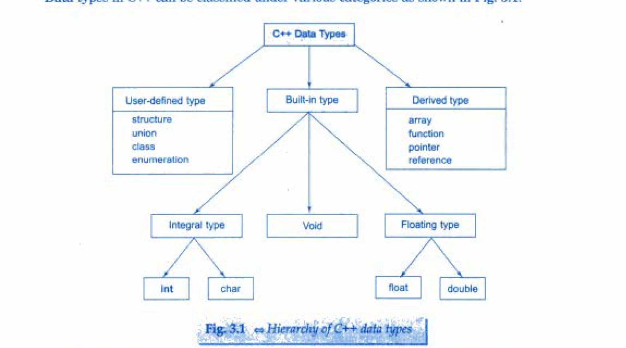
Data Types
Represents storage of data for a variable in RAM
As per requirement of type and range of data we can select appropriate data type.
A variable must be declared with appropriate data type before its’ use.

Slide 14
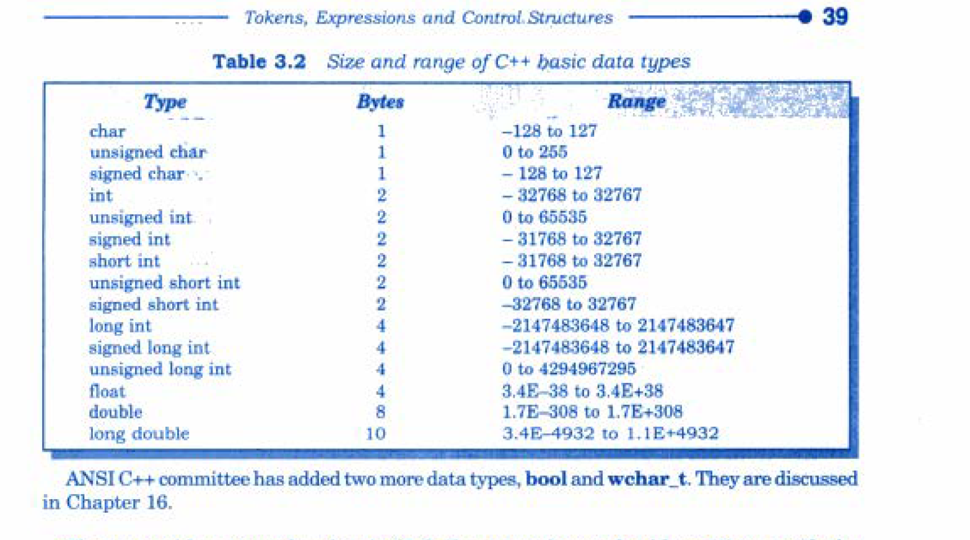
Data Types:Fundamental
Fundamental Data Types are basic types without which we can not work.
Also Known as Primitive or Primary or Built-in or Basic types

Slide 15
Formulae For Signed Type:
-2^{n-1} to +2^{n-1} -1
Formulae For UnSigned Type:
0 to 2^{n} -1
n= no. of bits used by the data type
i.e. int takes 2 bytes = 16 bits
range = -2¹⁶⁻¹ to +2¹⁶⁻¹ -1
= -2¹⁵ to +2¹⁵ -1
= -32,768 to +32,6767
Note: Default type of integer group is of type signed

Slide 16
Underflow: If we go beyond lower range then this problem occurs
Overflow: If we go beyond upper range then this problem occurs
Note#1: C/C++ does not give any warning in case of underflow or overflow conditions
Note#2: In such situations, variable will store garbage values.
Example: int a=32768;
cout<<a;

Slide 17
Data Types: Derived
Derived(Created) from primary data types:
Arrays :
int a[10];
char name[30];
2. Functions:
All library and user defined functions
3. Pointers:
int a=5;
int *p =&a;
cout<<*p;
4. Reference Variables:
int a=5;
int & b=a;
b=b+2;
cout<<a;

Slide 18
Data Types: User Defined
User can define his own data type
Structure :
Same concept as C but contains function as members.
2. Class:
Contains data and function as members.
3. Enum
Same as C
4. Typedef
Same as C
Example: typedef int marks;
marks sub1,sub2,sub3;

Slide 19
Data Types: User Defined:ENUM
Allows us to attach names to numbers to increase comprehensibility
The enum keyword automatically enumerates a list of words by assigning them values from 0,1,2,…
Syntax: enum tagname { val1, val2, ….., valn};
Example: enum direction {east, west, north, south};
enum colour{ red, green, blue, yellow};
enum switch_position {off, on};
Tag name becomes a new data type
Syntax: tagname var_name;
Example: colour bgc;
bgc =red;

Slide 20
Data Types: User Defined:ENUM
Example Program:
#include <iostream>
using namespace std;
enum direction {east, west, north, south};
int main()
{
direction dir;
dir = south;
cout<<dir;
return 0;
}

Slide 21
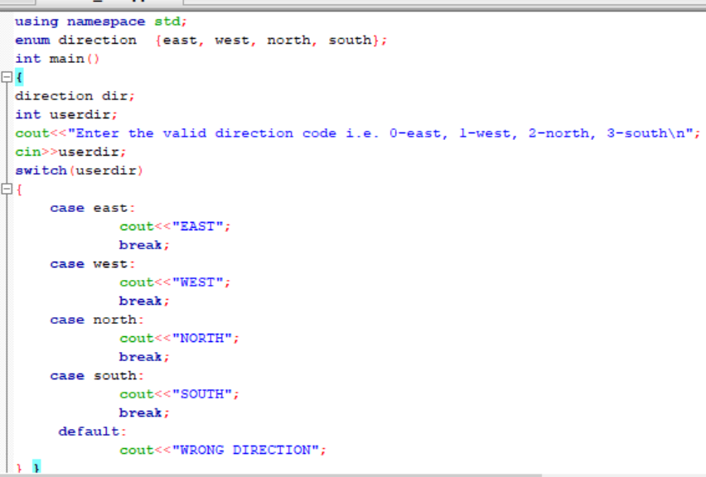
Data Types: User Defined:ENUM

Slide 22
Data Types: User Defined:ENUM
Why Enums?
Increases comprehensibility by assigning names to numbers
Enums are used only when we expect the variable to have one of the possible set of values.
They are used frequently are switch case statements, where all the values that case blocks expect can be defined in an enum

Slide 23
Symbolic Constant
It is difficult to change the values of constants in the entire program if they are used more than once.
i.e. value of π, g, λ, etc.
If we use Symbolic Constant then it solves two problems:
(i) Understanding : User can understand the constant
(ii) Modification : Multiple modifications with only one change
Example:
#define PI 3.14
void main()
{
float area= PI*2*2;
cout<<area;
}

Slide 24
Operators

Slide 25
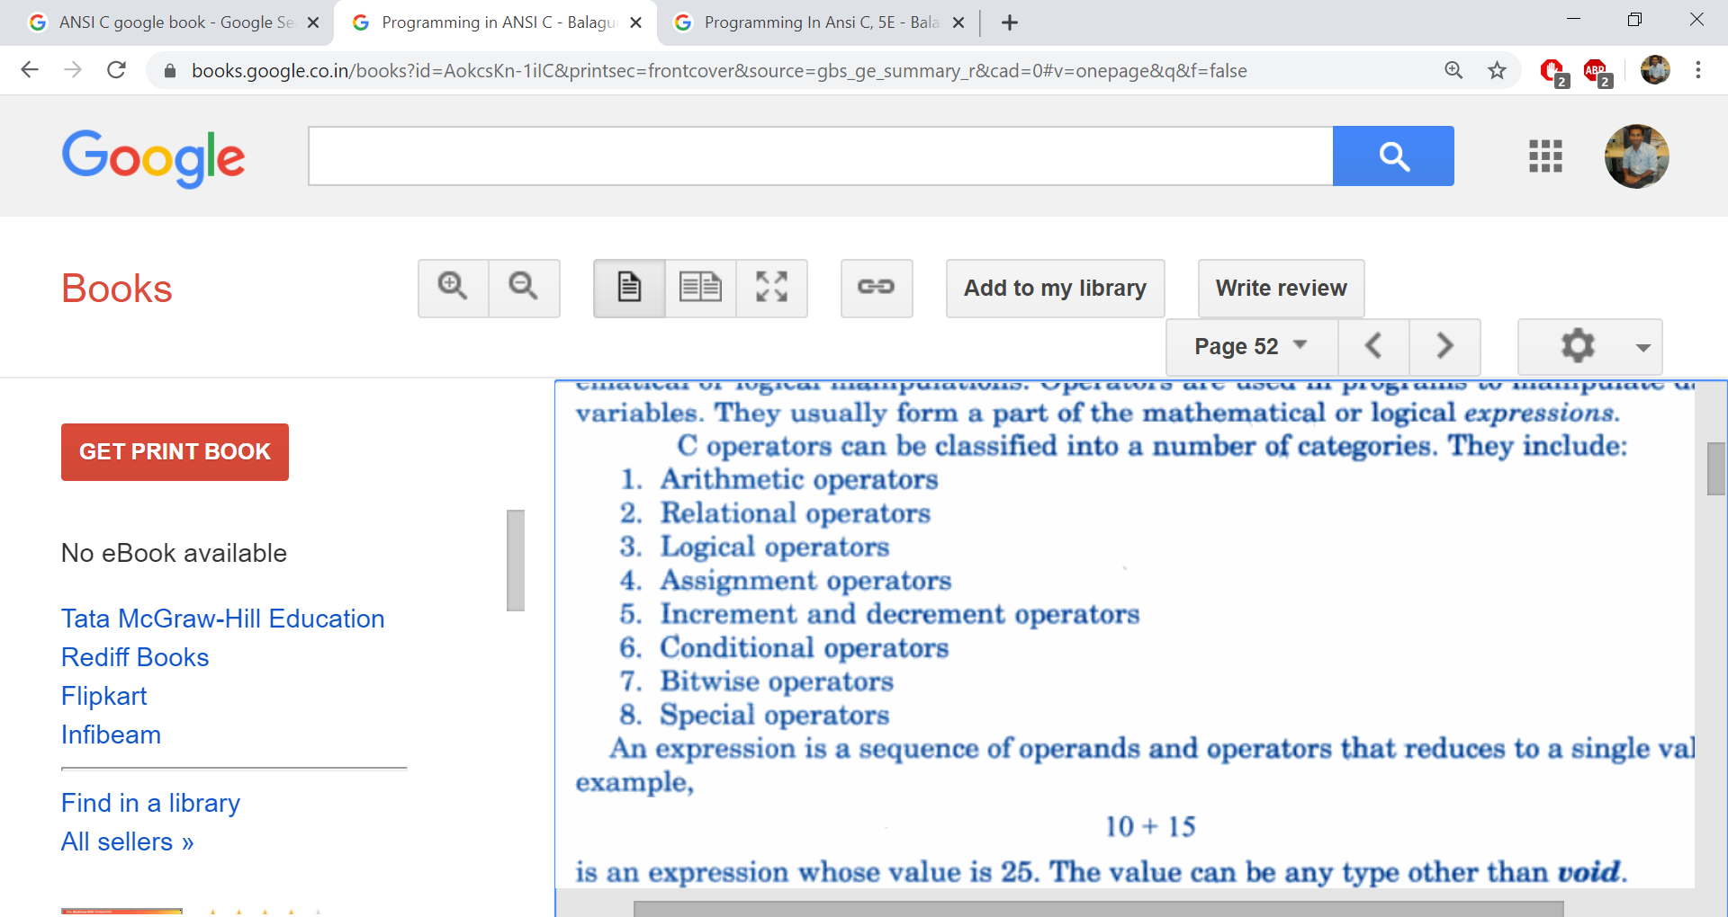
Types of Operators in C/C++

Slide 26
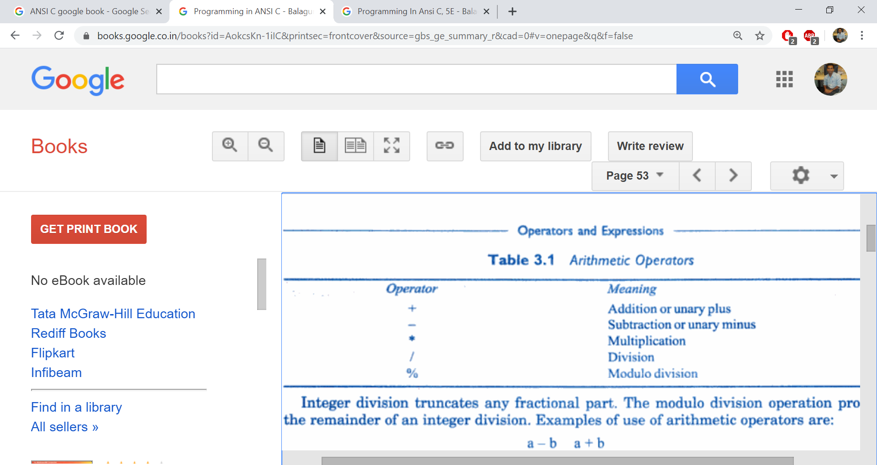
Arithmetic Operators
Note: Modulo operator can not be applied on floating point numbers in C/C++

Slide 27
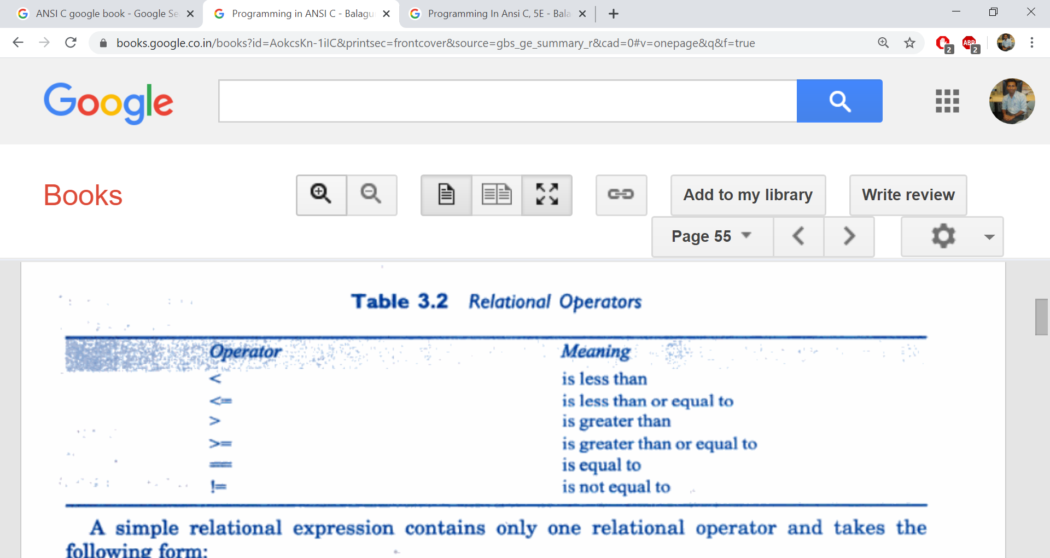
Relational Operators
Used to compare quantities in an expressioni.e. age of two persons, prices of two products, etc.
Example: a > b
The outcome of the relational expression is either 0 (false) or non-zero (true)
int a=5, b=2;
cout<<(a>b);
Output: 1

Slide 28
Logical Operators
Used to combine 2 or more relational expressions.
&& - Logical AND
|| - Logical OR
! – Logical NOT
Examples: (i) a>b && x<10
(ii) num%2==0 || num%5==0
(iii) num%4==0 && num%8==0
Truth Table for AND, OR, NOT

Slide 29
Conditional and Logical Operators used in the expression inside conditional statements i.e. if and loops i.e. for, while and do…while

Slide 30
Assignment Operator
Used to assign the result of an expression to the variable.
Syntax: var = expr;
Example: a=5;
b=4;
c=a+b;
C/C++ has a short hand notation for it
Syntax: var op= expr;
Example: a += 5; // a= a+5;

Slide 31
Increment and Decrement Operators
++ adds 1 to the operand and - - subtracts 1 from the operator.
i.e. a++; or ++a; is equivalent to a=a+1; or a+=1;
C/C++ provides two types of ++/- - operators :
(i) prefix and(++a) (ii) postfix (a++)
Note: The working of both is same if it is used stand alone
i.e. a++; or ++a;
But if used in an expression then:
Prefix is executed at the time of evaluation of an expression
a=7;
b = ++a;
cout<<b; // 8
Postfix is executed after the expression is evaluated.
a=7;
b = a++;
cout<<b; // 7

Slide 32
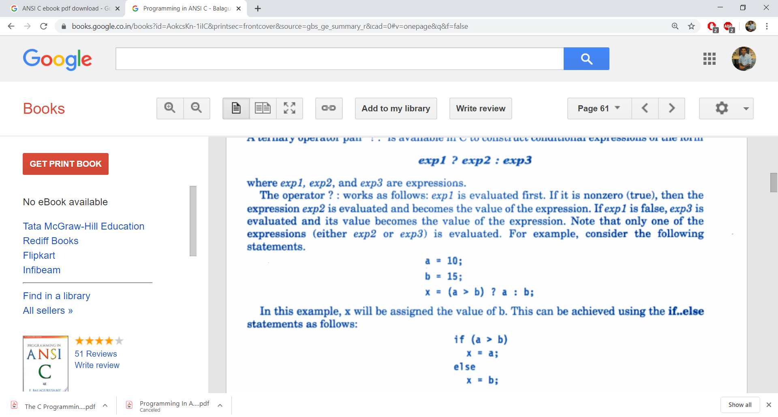
Conditional Operator
C/C++ provides a ternary operator :- ?:
Syntax:

Slide 33
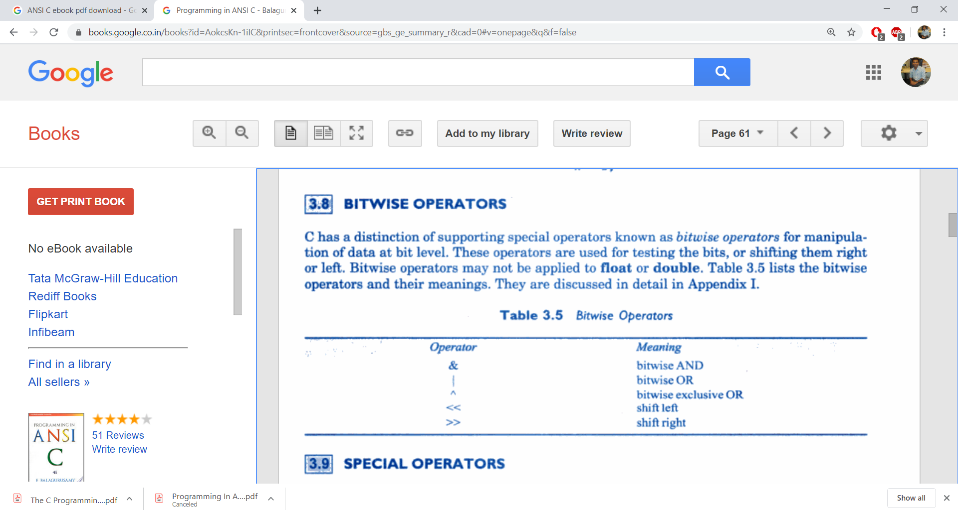
Bitwise Operators

Slide 34
Special Operators
C/C++ provides some special operators i.e. comma, sizeof, pointer operators(&,*) and member selection operators( . , ->)
Examples: comma > int a,b,c;
sizeof > cout<<sizeof(int); or cout<<sizeof(a);
pointer > int * p;
p=&a;
member selection operator:
b1.title=“NSI C”;
b1.quantity=13;

Slide 35
Type Conversion

Slide 36
Implicit Type Conversion
C/C++ permits mixing of constants and variables of different types in an expression.
It automatically converts any intermediate value to its proper type so significance is not lost.
This conversion is known as Automatic/Implicit type conversion
Example: int a, x;
long b;
float f;
double d;
x = a + b - f + d;
(int) + (long) -> long
(long) – (float) -> float
(float) + (double) -> double
So, double value will be assigned in x;

Slide 37
In Type Conversion, lower type is promoted to higher type

Slide 38
Explicit Type Conversion
Sometimes, we have to perform type conversion in an expression as per the need.
Example: int a=5,b=2;
float c = a/b;
cout<<c;
In this case both a and b are integers but the division must come in float. With implicit type casting, we get the wrong answer.
To get correct answer we have to temporarily make either a or b as float while evaluating the expression:
float c = (float)a / b; // or a / (float) b;
This process is called Explicit Type Conversion
Syntax: (target-type) expr;

Slide 39
Operator Precedence & Associativity

Slide 40
Operator Precedence
i.e. d = a / b + c;
In this case / has higher precedence so it is served at first and then +
Every operator in C/C++ is given some precedence(priority) level.
If an expression contains more than one operator, it is evaluated as per the precedence of an operator.

Slide 41
Operator Associativity
The operators having same precedence are evaluated either “left-to-right” or “right-to-left” depending on the level.
This property is called the associativity.
i.e. f = a * b + c – d / e;
Here, both * and / has higher priority than + and –
Both * and / has same precedence
Both are having associativity ‘left-to-right’ so each will be served from left to right.
So, at first a * b will be evaluated then d / e and then + and -

Slide 42
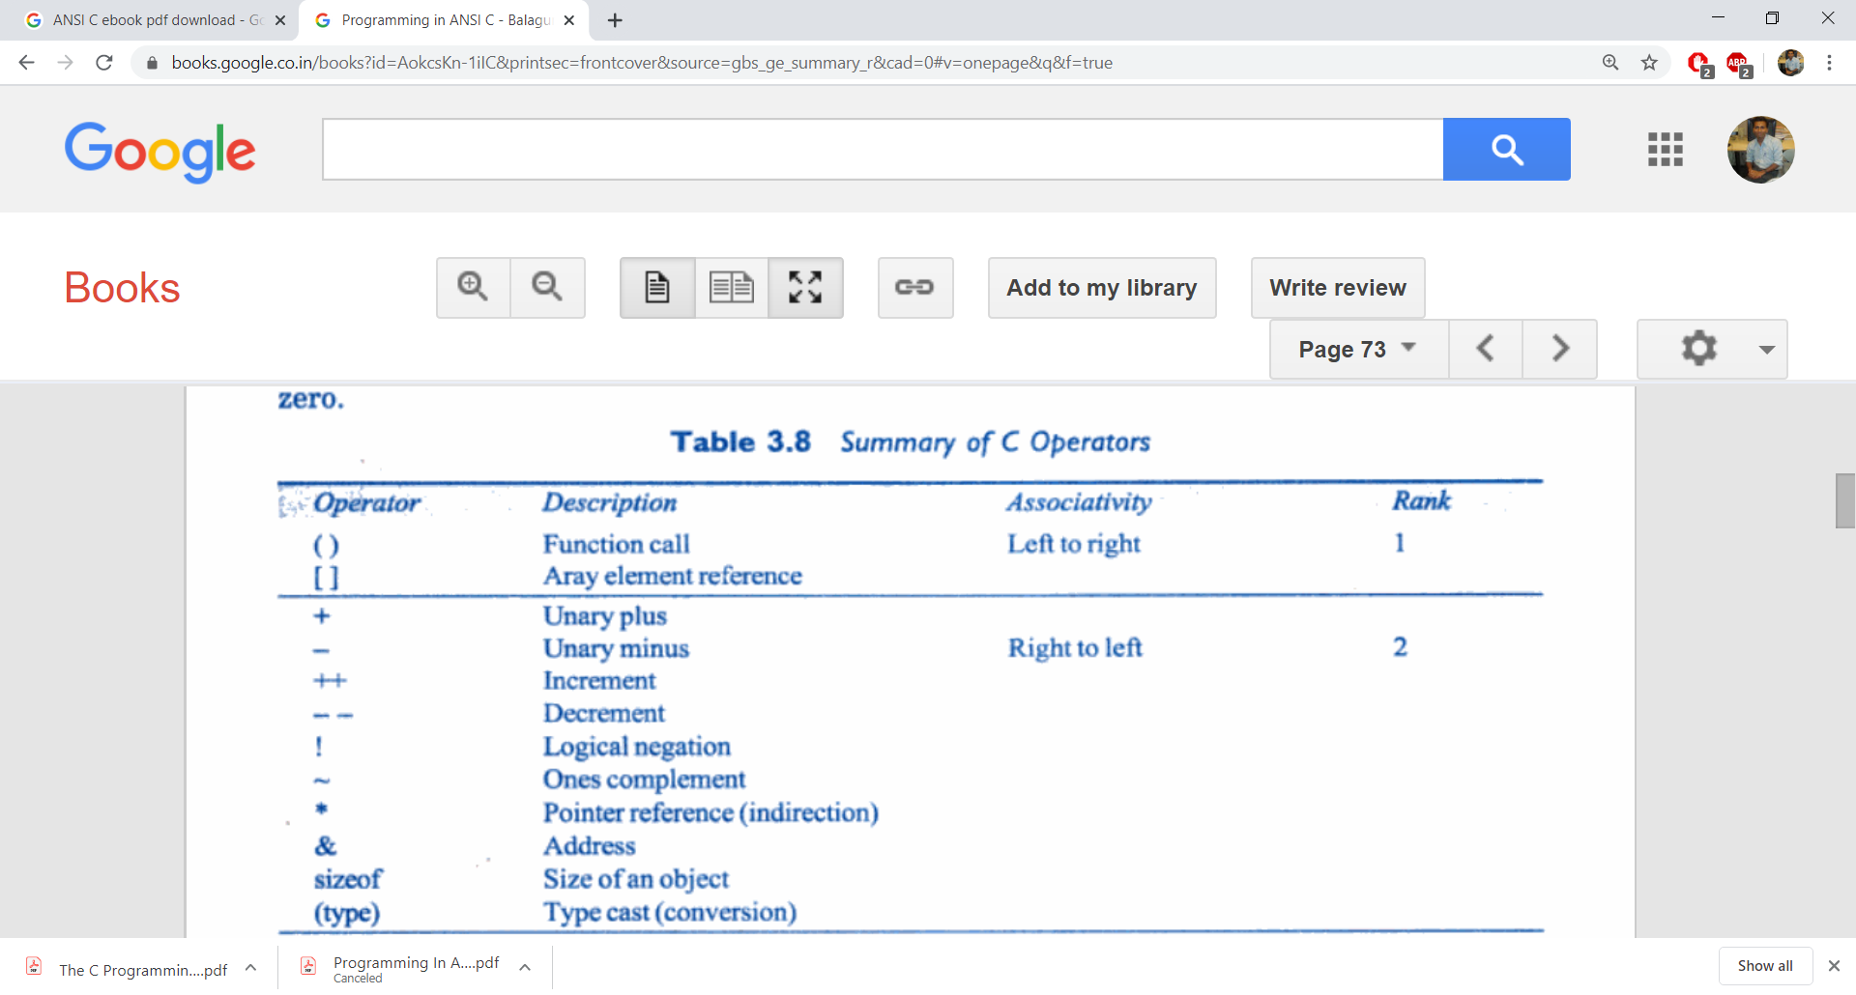
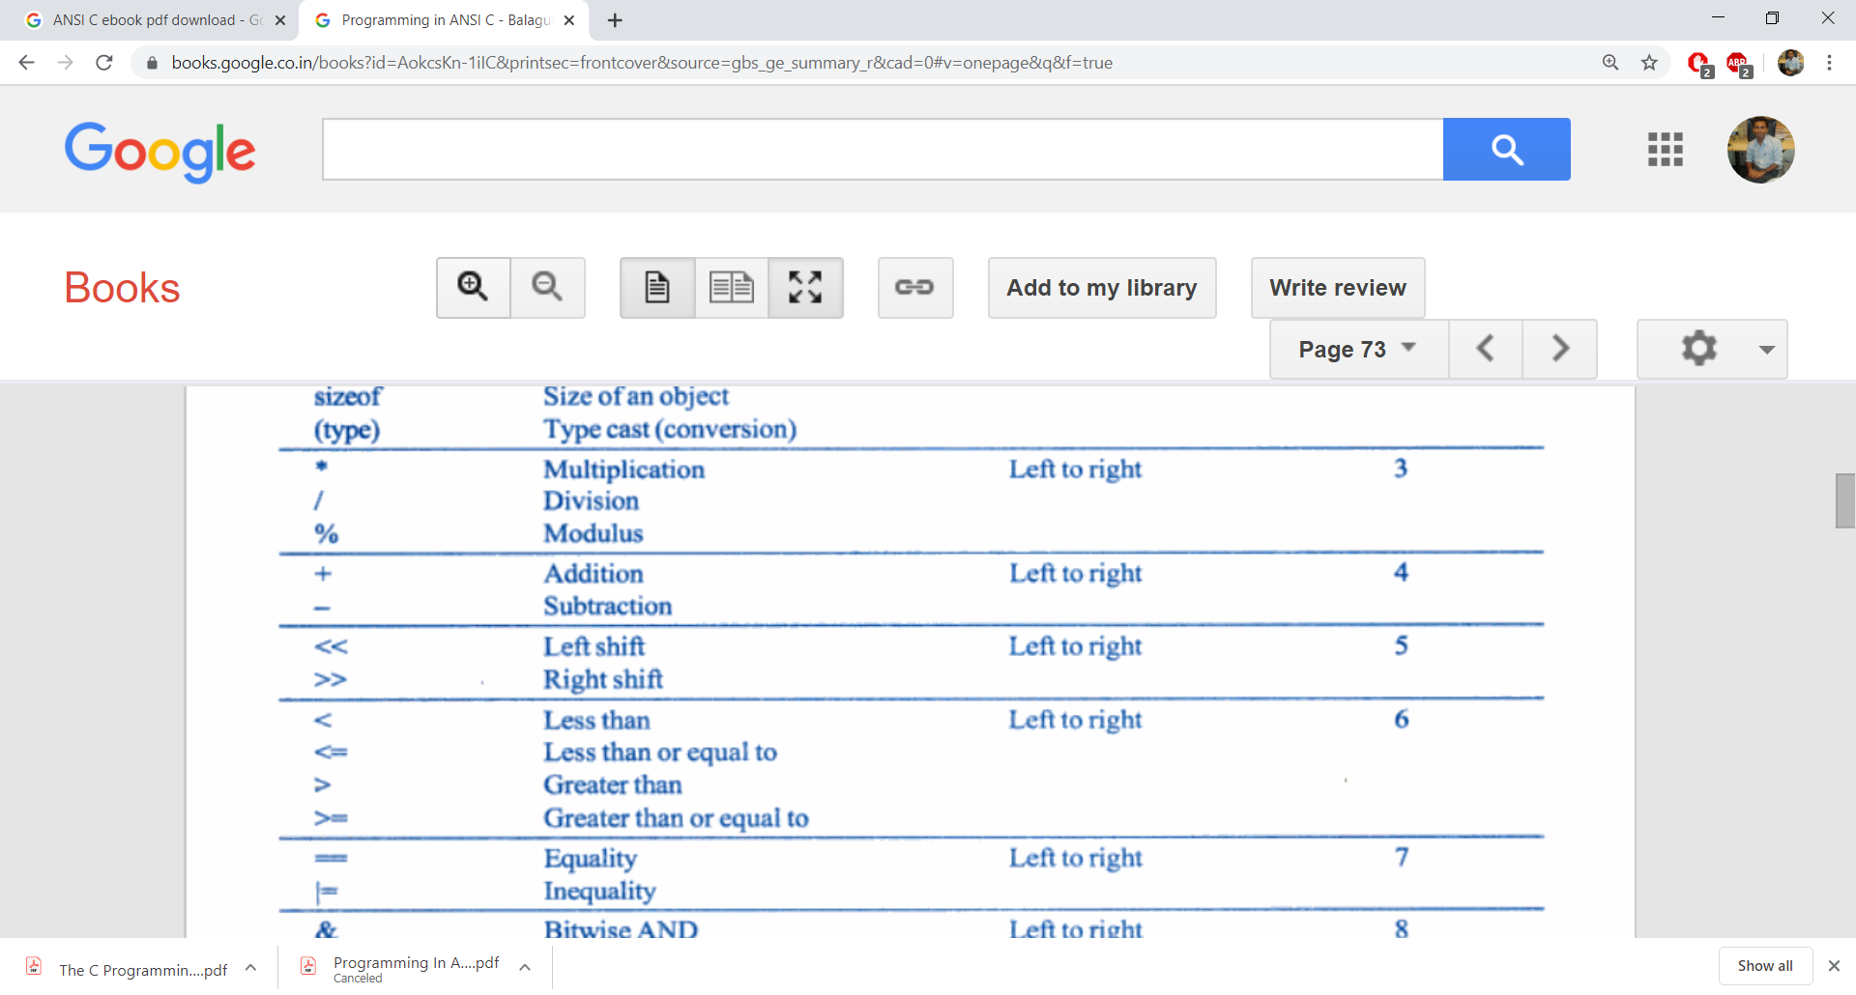
Operator Precedence in C

Slide 43
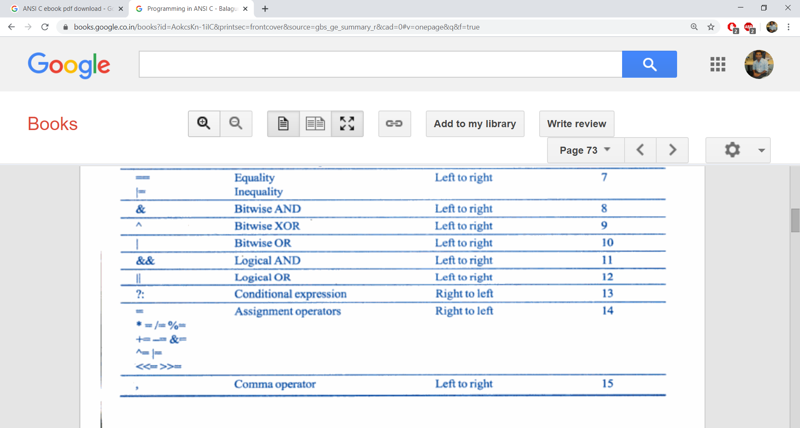
Operator Precedence in C

Slide 44
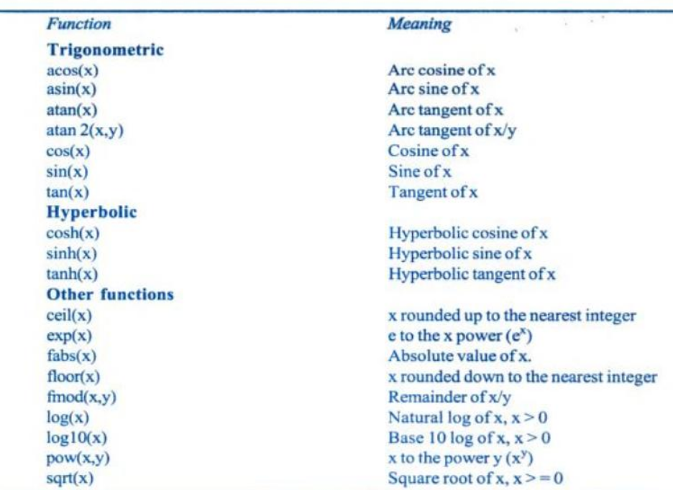
Mathematical Functions

Slide 45
Exercise Questions

Slide 46
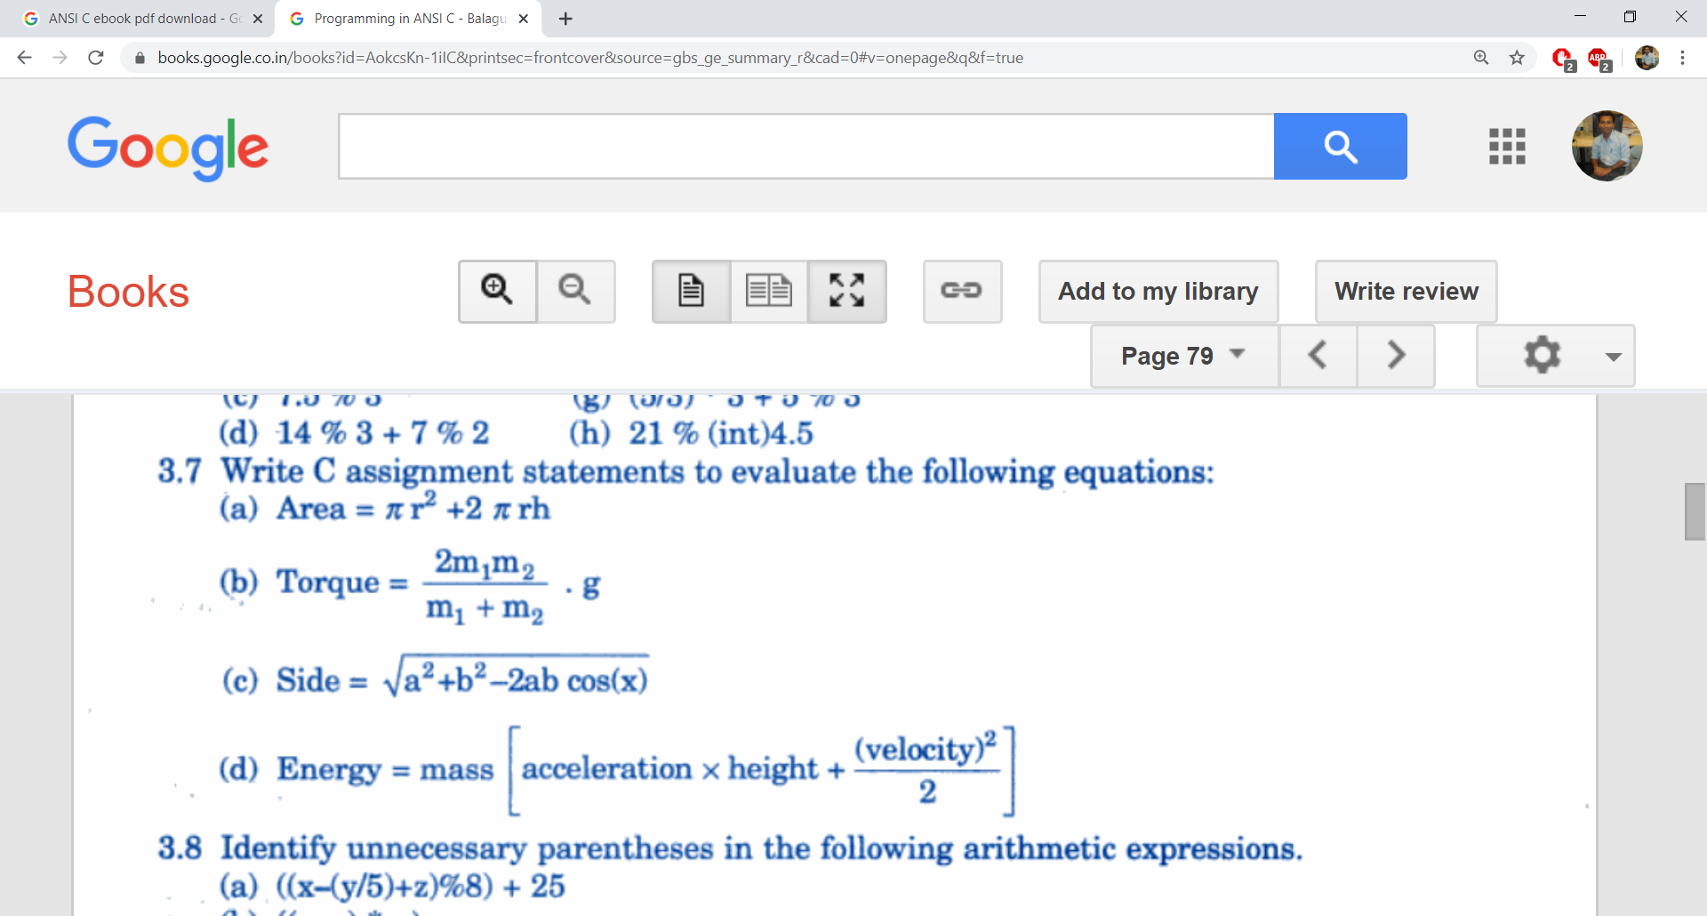
Exercises
Q:1

Slide 47
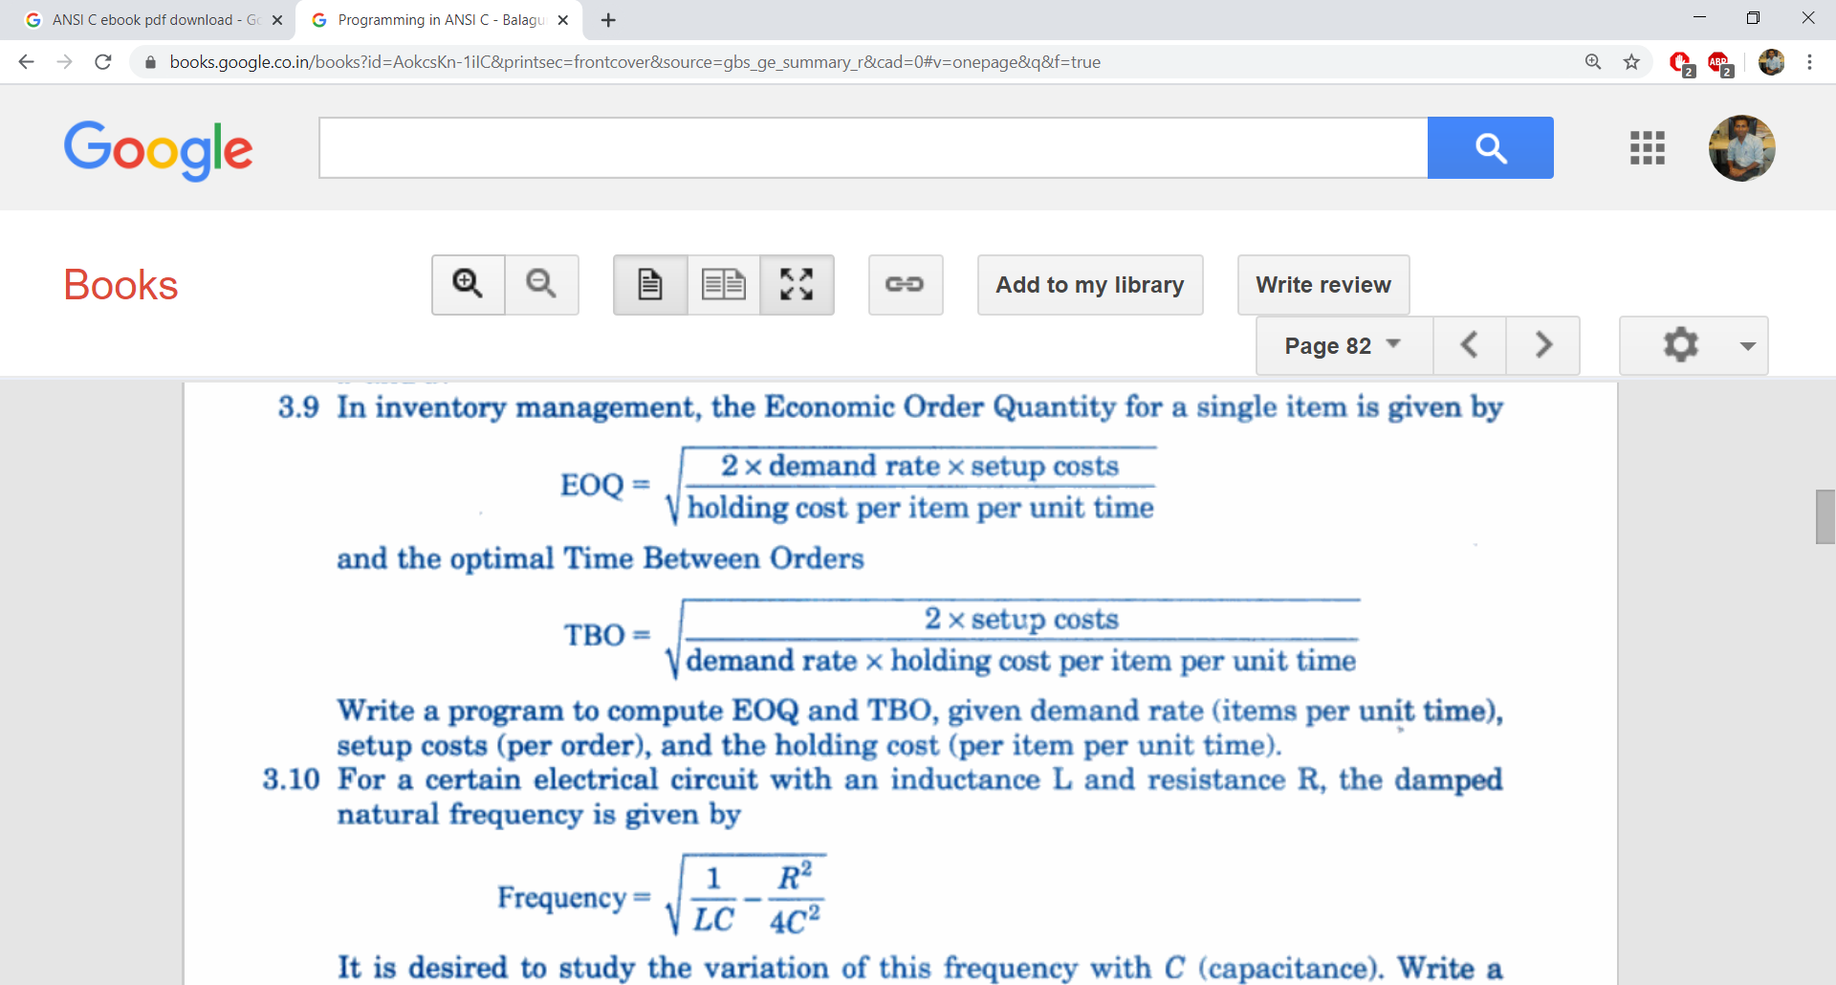
Exercises
Q:1

Slide 48
Exercises
Q:2
A Computer manufacturing company has the following monthly compensation policy for their sales persons:
Basic Salary : Rs. 15000
Bonus for Every Computer Sold: Rs. 2000
Commission on total sales (at the end of the month): 2%
Find out the total salary of the sales person.

Slide 49
Exercises
Q:2 Write a program to convert temperature from Fahrenheit to Centigrade.
Q:3 Write a program to find female to male ratio.
Q:4 Write a program to find average of three numbers.
Q:5 Write a program to find roots of quadratic equation.

Slide 50
Thanks!
Any questions?
You can find me at:
manish_ratilal2002@yahoo.com

Slide 51
Credits
Object Oriented Programming with C++, E Balagurusamy, TMH

